Slide 1
CS5590 Applied Programming Series
Programming for Web/Cloud based Application

Slide 2
HTML
CSS

Slide 3
HTML

Slide 4
HTML
HyperText Markup Language
HTML is the language used to build websites
It forms the basic structure of a web page
All text and content that you see on the internet is built using HTML

Slide 5
Element
Basic building block of HTML.
e.g. paragraphs, headings, links, lists
<tagname>Content goes here</tagname>
<h1>Owls...</h1>
Some elements don’t have closing tags
<img src="images/img1.jpg" alt="adorable">

Slide 6
Webpage Structure
<!DOCTYPE html> <html> <head> <title>I love owls</title> </head> <body> </body> </html>

Slide 7
Webpage Structure
<!DOCTYPE html>
tells the browser about html version <html></html>
contains the contents of your page <head></head>
meta information, stylesheets, scripts <body></body>
Contains visible webpage contents

Slide 8
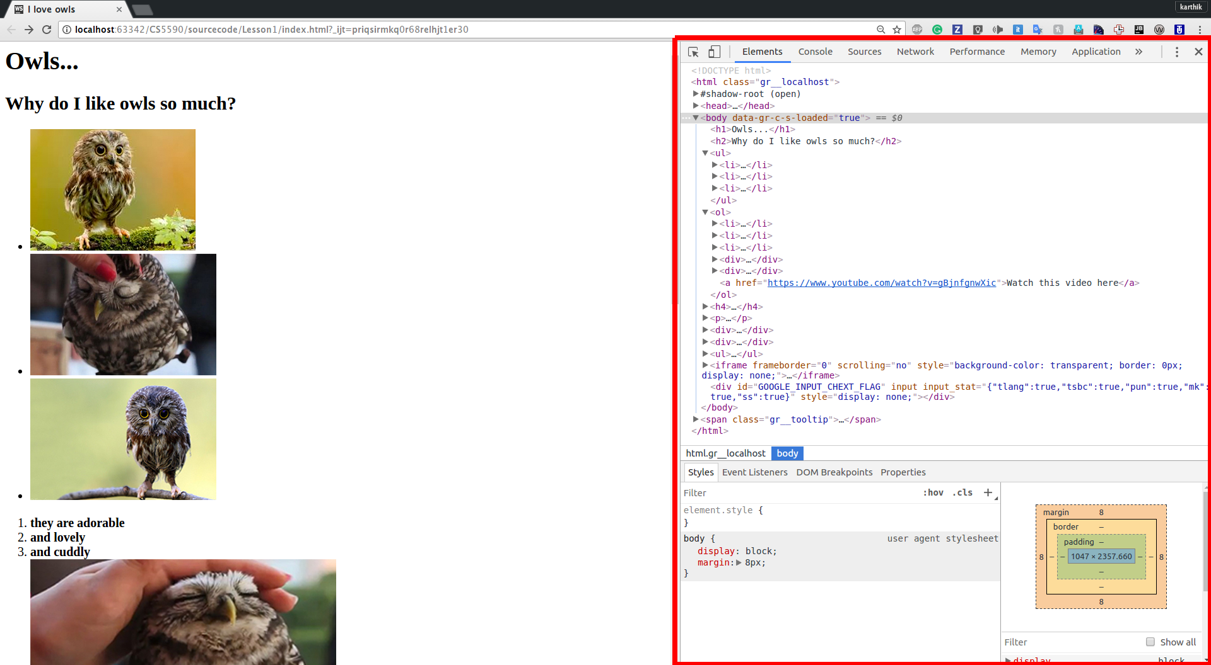
Developer Tools

Slide 9
Headings
6 sizes
h1-most important,h6-least important
<h1>This is heading 1</h1> <h2>This is heading 2</h2> <h3>This is heading 3</h3> <h4>This is heading 4</h4> <h5>This is heading 5</h5> <h6>This is heading 6</h6>

Slide 10
Paragraph <p>
defines a paragraph
<p>Most birds of prey sport eyes on the sides of their heads, but the stereoscopic nature of the owl's forward-facing eyes permits the greater sense of depth perception necessary for low-light hunting. </p>

Slide 11

Link <a>
lets the user click through to another webpage
attribute "href" indicates where user wants to go
"target" attribute specifes where to open the linked document
<a href="https://en.wikipedia.org/wiki/Owl"
target="_blank">More information about owls...</a>

Slide 12
Div <div>
lets you group elements together
Grouping elements is useful to style them together
<div> <h1>Owls</h1> <p> Most birds of prey sport eyes on the sides of their heads <a href="https://en.wikipedia.org/wiki/Owl">More information about owls...</a> </p> </div>

Slide 13

List <li>
Two types-ordered and undordered
Ordered –numbered sequence
Undordered-defined with bullets
<ol> <li>they are adorable</li> <li>and lovely</li> <li>and cuddly</li> </ol>

Slide 14
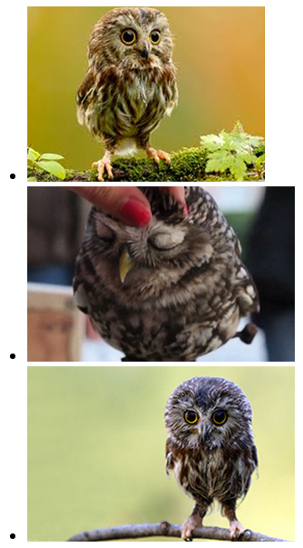
List <li>
<ul> <li><img src="images/img1.jpg" alt="adorable"></li> <li><img src="images/img2.jpg" alt="lovely"></li> <li><img src="images/img3.jpg" alt="cuddly"></li>
</ul>

Slide 15
Image <img>
src attribute specifies the URL of the image
alt attribute provides an alternate text for an image
<img src="images/img1.jpg" alt="adorable">

Slide 16

Block and Inline Elements
Block: always starts on a new line and takes up the full width available
e.g.<p> ,<form>,<h1>-<h6>,<div>
Inline: does not start on a new line, only takes up as much width as necessary
e.g. <a>,<img>,<span>

Slide 17
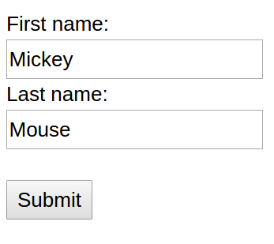
HTML Forms
<form action="/action_page.php"> First name:<br> <input type="text" name="firstname" value="Mickey"><br> Last name:<br> <input type="text" name="lastname" value="Mouse"><br><br> <input type="submit" value="Submit"> </form>

Slide 18
Form Elements
Tag | Description
<input> | Defines an input control
<textarea> | Defines a multiline input control
<select> | Defines a drop-down list
<button> | Defines a clickable button
There are different types of inputs depending on the "type" attribute
There are many other form elements.
Open facebook in incognito mode and inspect the form elements for login/signup
https://www.facebook.com/

Slide 19
HTML5
Simplified DOCTYPE declaration
New Semantic elements like <header>,<footer> and attributes like calender,range
New graphic(<svg> , <canvas>) and multimedia(<audio>,<video> elements
Many new interesting APIs like Geolocation, drag and drop, Local Storage

Slide 20
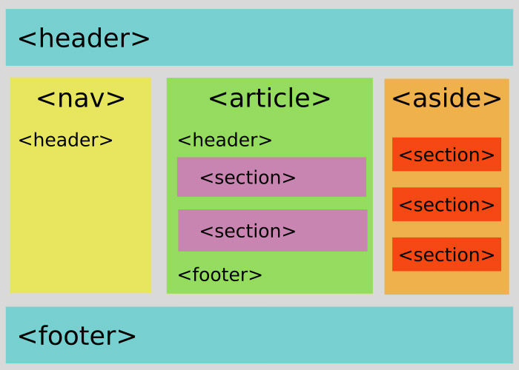
Semantic Elements
<div>,<span> - do not tell about content
<nav>,<article> -clearly define content
http://www.hongkiat.com/blog/html-5-semantics/

Slide 21
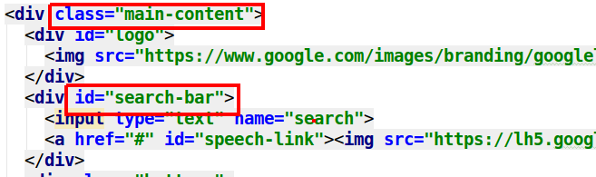
Class, id Attributes
Class is a html attribute that is used to set style to the html elements
Id is similar to class but it should be unique and restricted to only one element

Slide 22
CSS

Slide 23
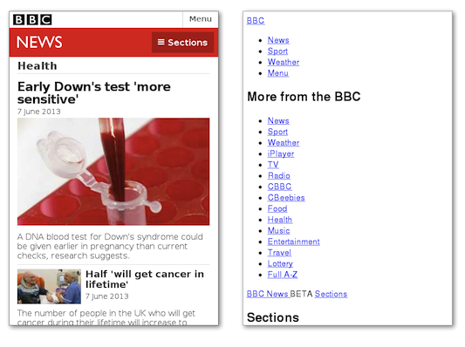
Cascading Style Sheets (CSS )
describes how HTML elements should be displayed

Slide 24
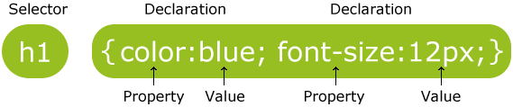
syntax
Selector-point to element to be styled
Declaration-contains comma seperated name-value pairs of properties and values

Slide 25
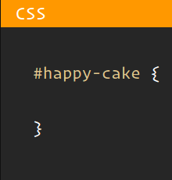
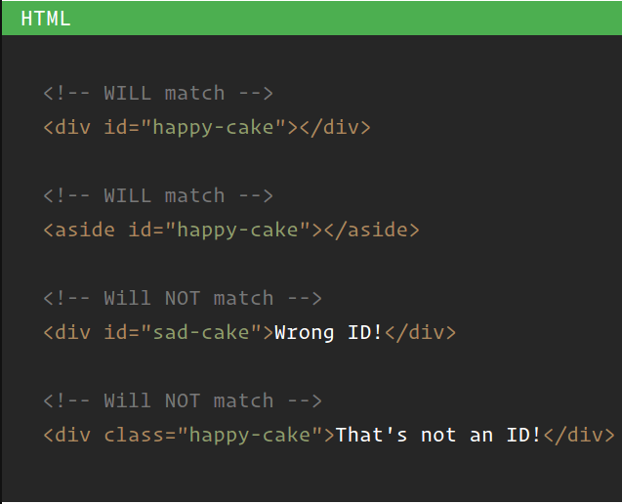
Selectors –id selector

Slide 26
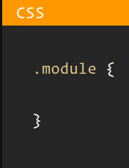
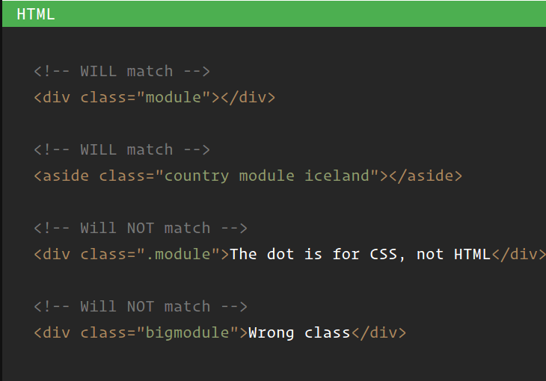
Selectors –Class selector

Slide 27
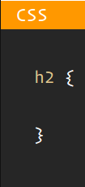
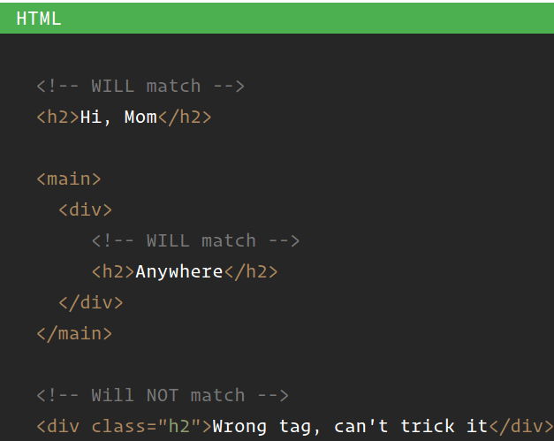
Selectors – Tag selector​

Slide 28
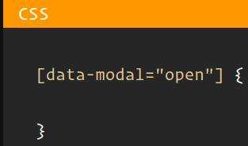
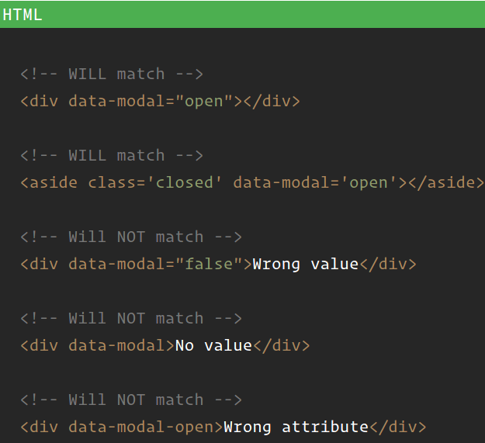
Selectors – Attribute selector

Slide 29
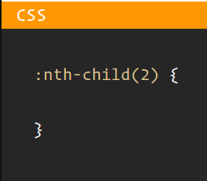
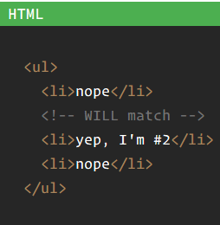
Selectors –Positional selector

Slide 30
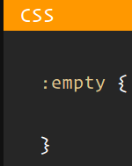
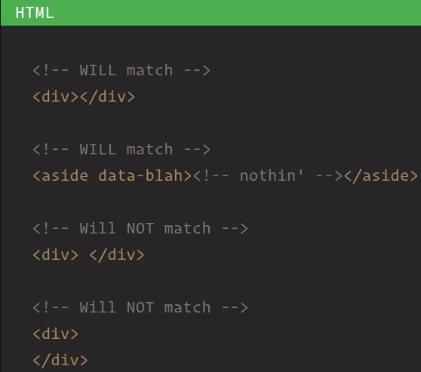
Selectors – Pseudo selector

Slide 31
Pseudo Class
used to define special state of an element.
Eg: -Style an element when a user hovers on it
-Style visited and unvisited links
Syntax: Example
/* mouse over link */ a:hover { color: #FF00FF; }
selector:pseudo-class { property:value; }

Slide 32
Pseudo Element
used to style specified parts of an element.
Eg: Style first letter, or line, of an element
Insert before/after its content
Syntax Example
selector::pseudo element { property:value; }
p::first-line { color: #ff0000; font-variant: small-caps; }

Slide 33
Pseudo Elements
Selector | Example | Example description
::after | p::after | Insert something after the content of each <p> element
::before | p::before | Insert something before the content of each <p> element
::first-letter | p::first-letter | Selects the first letter of each <p> element
::first-line | p::first-line | Selects the first line of each <p> element
::selection | p::selection | Selects the portion of an element that is selected by a user

Slide 34
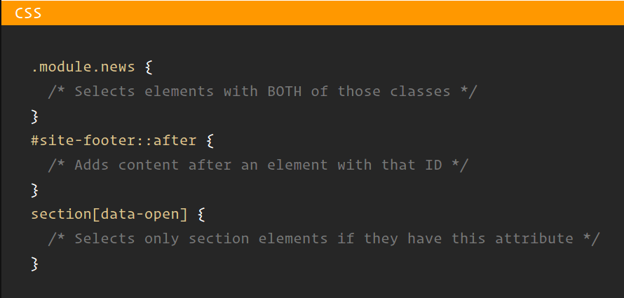
Selectors – Combination

Slide 35
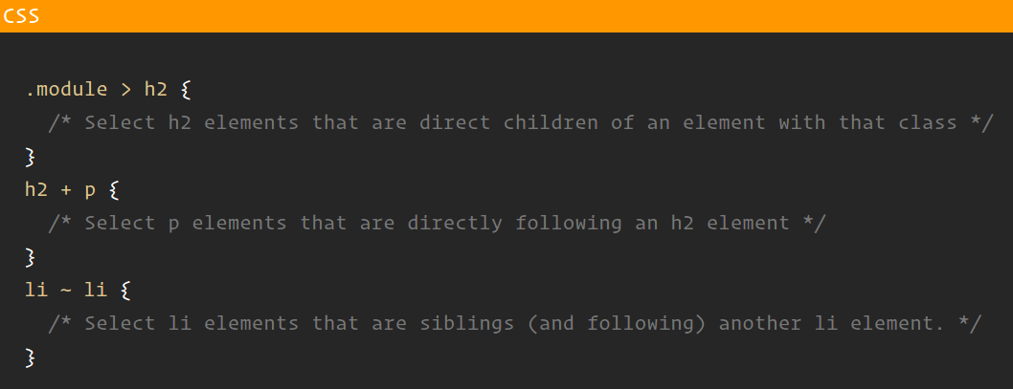
Selectors – Combination

Slide 36
Inserting CSS
External-In a separate external file
<head> <link rel="stylesheet" type="text/css" href="mystyle.css"> </head>
Inline -as a style attribute for an element
<h1 style="color:blue;margin-left:30px;">This is a heading</h1>

Slide 37
Inserting CSS
Internal-In the head of html between script tags.
<head> <style> body { background-color: linen; } h1 { color: maroon; margin-left: 40px; } </style> </head>

Slide 38
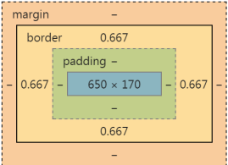
Box Model
Content - content of the box(text/image)
Padding - Clears area around content.
Border - border around padding & content
Margin - Clears an area outside border
Total element width=width+ left padding+ right padding + left border+ right border+ left margin+ right margin

Slide 39
Box-sizing
allows us to include the padding and border in an element's total width and height.
Without box-sizing,
width + padding + border = actual width of an element
* { box-sizing: border-box; }

Slide 40
Outline Vs Border
Outline is drawn around elements (outside the borders) to make the element "stand out"
The outline is NOT a part of an element's dimensions and does not occupy any space unlike border
Outline can be not rectangular
It can not be set on specific sides like borders

Slide 41

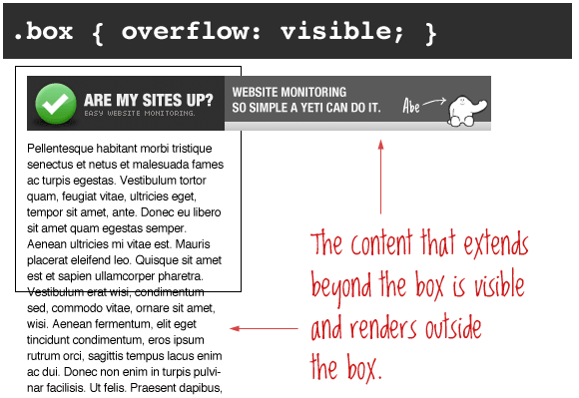
Overflow

Slide 42

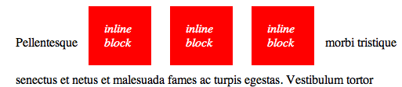
display
display:none;
Element is removed visually but is still in DOM

Slide 43
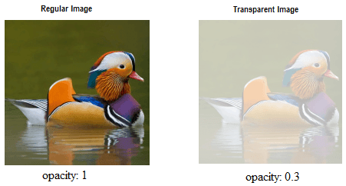
Opacity
specifies transparency of an element.

Slide 44
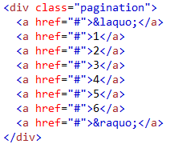
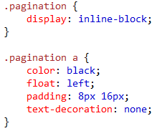

Pagination
HTML
CSS

Slide 45
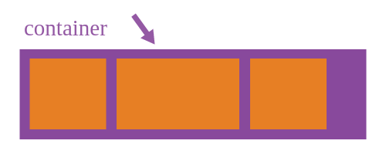
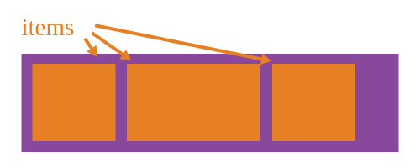
Flexbox
Flexbox=container+item
Container Items
Display
Flex-direction
Flex-wrap
Flex-flow
(short hand of flex direction and flex wrap)
Justify-content
Align-items
Align-content
Order
Flex-grow
Flex-shrink
Flex-basis
Flex(shorthand of flex-grow,flex-shrink,flex-basis)
Allign-self

Slide 46
Display,flex-direction
Display can be block or inline
Flex-direction defines the direction flex items are placed in the flex container
display flex-direction
.container { display: flex; /* or inline-flex */ }
.container { flex-direction: row | row-reverse | column | column-reverse; }

Slide 47
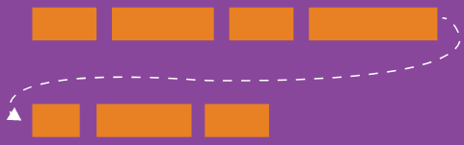
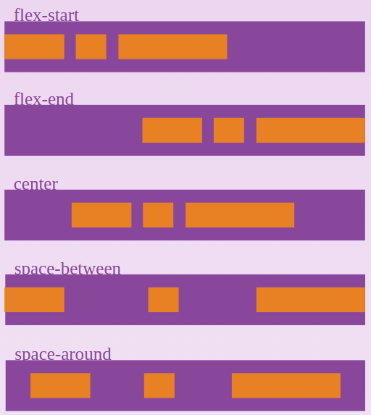
flex-wrap, justify-content
the default value of flex-wrap is nowrap .
justify-content gives alignment on main axis .
.container{ flex-wrap: nowrap | wrap | wrap-reverse; }
.container { justify-content: flex-start | flex-end | center | space-between | space-around; }

Slide 48
align-items, align-content
Aligns-items gives behaviour of flex items along the cross axis
Align-content aligns container's lines within when there is extra space in the cross-axis
align-items align-content
.container { align-items: flex-start | flex-end | center | baseline | stretch; }
.container { align-content: flex-start | flex-end | center | space-between | space-around | stretch; }

Slide 49
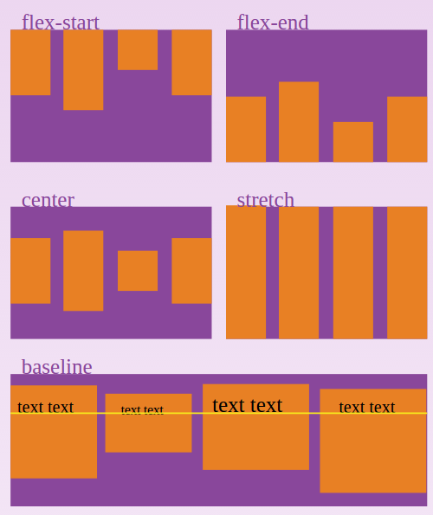
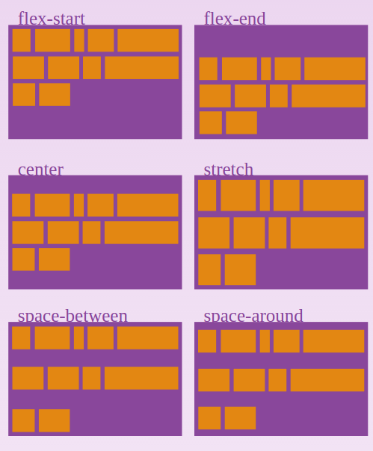
align-items align-content

Slide 50

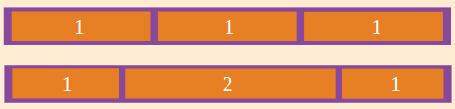
Order,flex-grow
Order property controls the order in which items appear
Flew-grow decides amount of available space an item can take
Click t.item { flex-grow: <number>; /* default 0 */ }o add text
.item { order: <integer>; }

Slide 51
Flex-shrink,flex-basis
Flex-shrink defines ability of an item to shrink if necessary
Flex-basis defines default size of an item before remaining space is distributed. "auto" takes its width or height appropriately
}
item { flex-shrink: <number>; /* default 1 */ }
.item { flex-basis: <length> | auto; /* default auto */ }

Slide 52
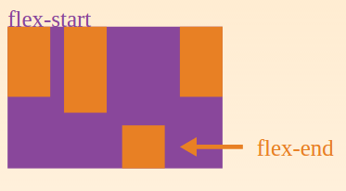
align-self
allows the default alignment (or the one specified by align-items) to be overridden for individual flex items.
.item { align-self: auto | flex-start | flex-end | center | baseline | stretch; }

Slide 53
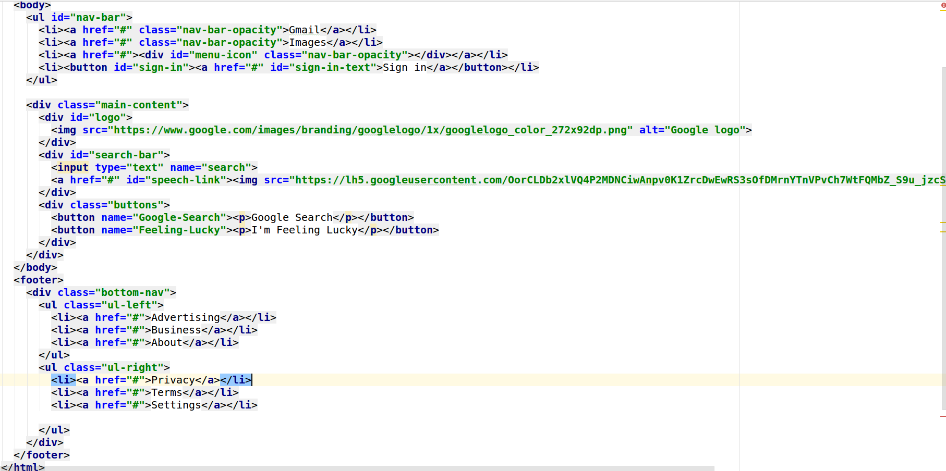
UseCase-1:Google Home Page

Slide 54
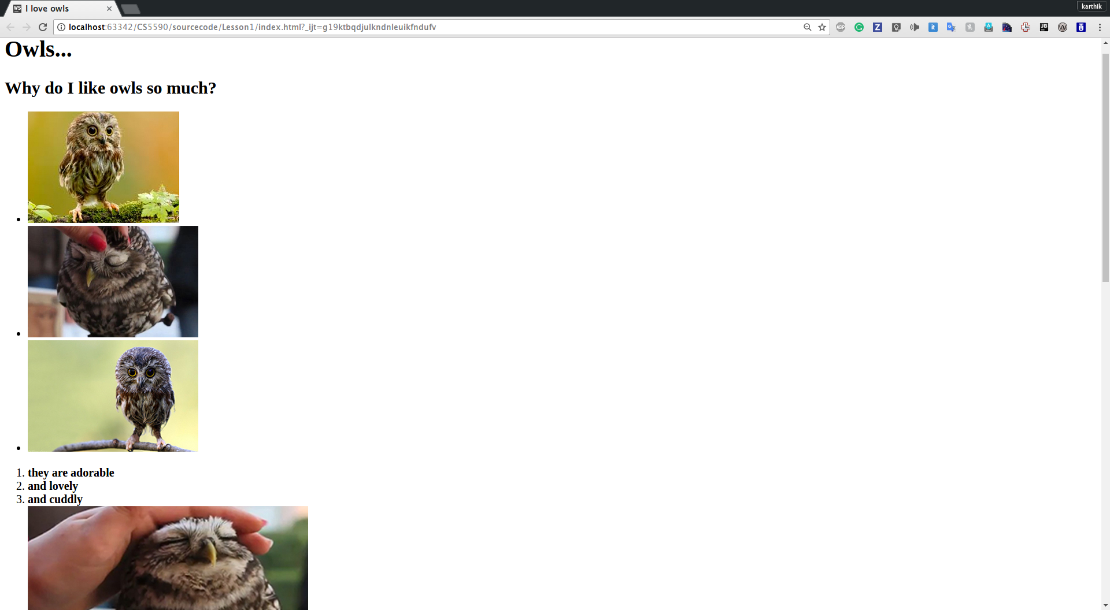
UseCase-A Simple HTML Page

Slide 55
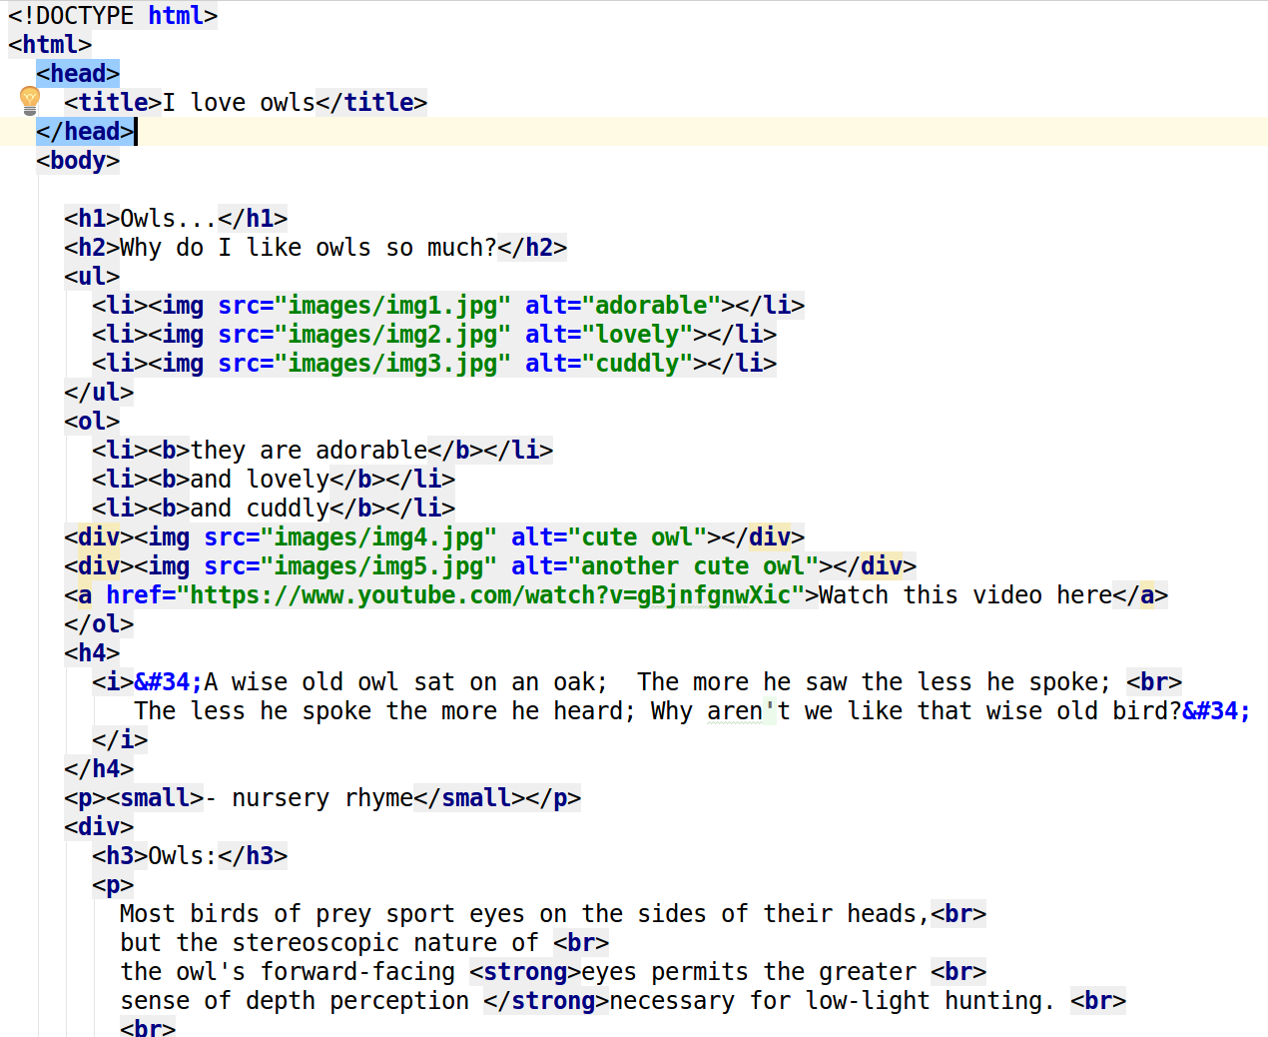
Use Case-A Simple HTML Page

Slide 56
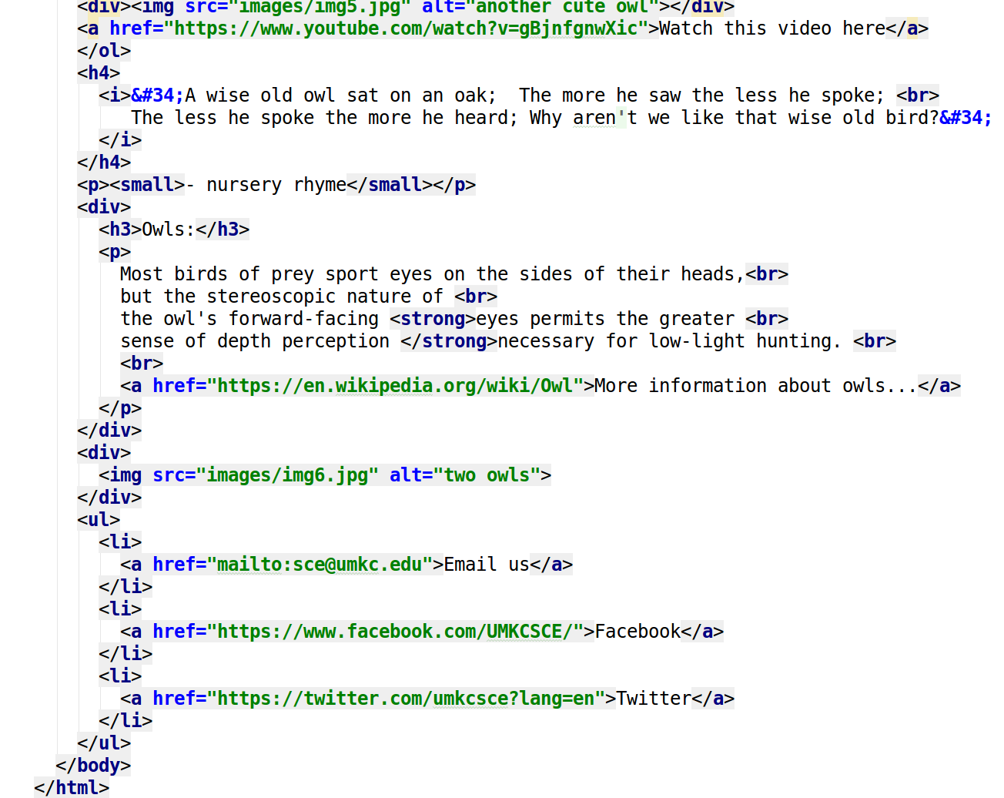
Use Case-A Simple HTML Page

Slide 57
In Class Exercise-HTML Task
Show that you have WebStorm installed on your machine.
Create GitHub Account. Create a repository in remote GitHub. Clone it to local machine. Create two (Source and Documentation) directories in local GitHub
Take screenshots of a repository creation and put them in the documentation folder in the local repository and sync it to remote repository
Create a html document named “index.html” and place it in the source folder. Inside the html document write a report explaining what you did during the creation of the Git repository with screenshots included as images. The page should contain paragraphs, headings, unordered list,ordered list,at least two div & span elements. The screenshots stored in documentation should be displayed as images at appropriate locations in the html file and should be clickable i.e. when you click the image, it should redirect you to the location of the image in the documentation in a new tab.

Slide 58
In Class Exercise –HTML Task
The html page should also include a relevant YouTube video
The video should have controls like play, pause, etc.
Sync both local repository with the source and documentation folders with the remote repository.

Slide 59
In Class Exercise-CSS Task
Download the source code from the google sheet. Add the notifications icon and your image in the corner of the page provided to you and the recently opened tabs below the search bar of google as shown in this image

Slide 60
Assignment
Assignment: https://umkc.box.com/s/kbvx192ov712b27hjfe705qeevlsabhe
Submission Link: https://goo.gl/forms/cDmMhPECPYLAsSSh2

Slide 61
Wiki: Lab Submission
Create a repository for all Lab assignment submissions
Create a folder for each lab assignment and place all code inside source code folder
Use Github wiki pages to submit reports for each lab
Include all wiki links in README.md file

Slide 62
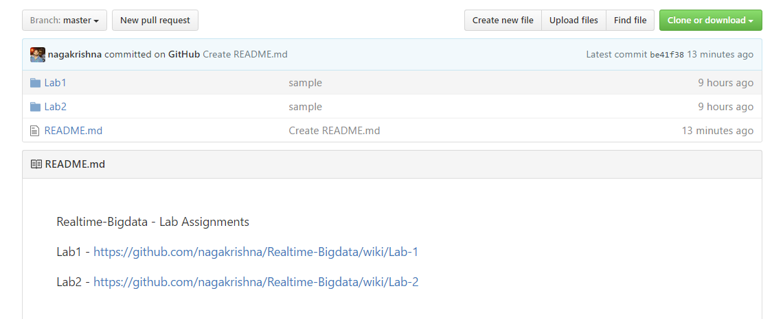
Wiki: Lab Submission

Slide 63
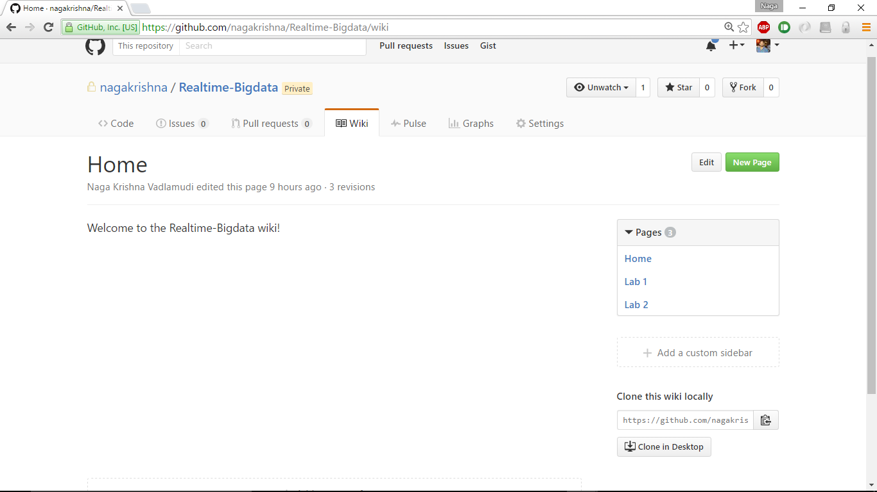
Wiki: Lab Submission

Slide 64
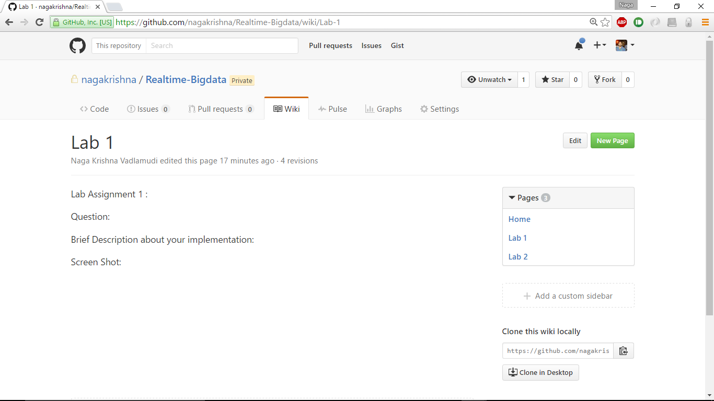
Wiki: Lab Submission

Slide 65
References
https://developer.mozilla.org
https://www.w3schools.com
https://codebar.io
http://www.hongkiat.com
https://ariya.io
https://css-tricks.com
http://www.corelangs.com

